Slide 1
Microsoft Power BI

Slide 2
Report Authoring and Customization with Power BI Embedding
Ted Pattison
Principal Program Manager
Power BI Customer Advisory Team (PBICAT)

Slide 3
Welcome to Power BI Dev Camp
Power BI Dev Camp Portal - https://powerbidevcamp.net

Slide 4
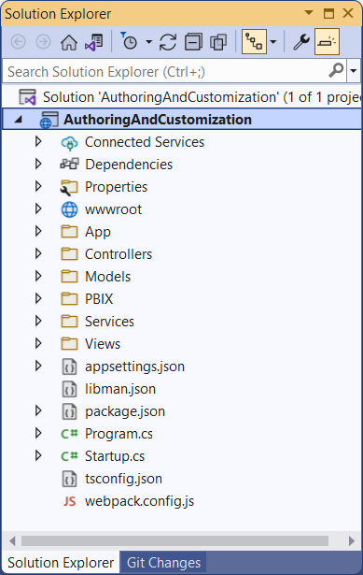
Developer Sample: AuthoringAndCustomization
Developer sample demonstrates App-Owns-Data embedding techniques
Implemented as C#/.NET6 web application which uses the Power BI .NET SDK
Download from https://github.com/PowerBiDevCamp/PBIE-Authoring-And-Customization
{F5}

Slide 5
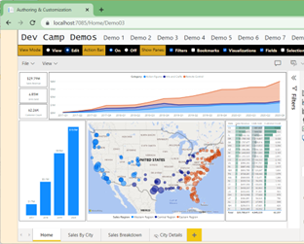
Developer Sample based on SPA Architecture
Each AuthoringAndCustomization demo page runs as a Single Page Application (SPA)
HomeController returns HTML for each page along with JavaScript viewModel with embedding data
Some demo pages require Web API callbacks after initial page has loaded
Demo08 includes Web API callbacks that read and write to underlying SQL database
CAVEAT: This is a proof-of-concept (POC) application with no user authentication or authorization
HomeController
EmbedTokenController
Bookmarks Controller
AppOwnsDataCustomizationDB

Slide 6
Agenda
Initializing and Customizing Report Pages
Creating Custom Navigation with Pages and Bookmarks
Creating Authoring Experiences with the Report Designer
Creating New Pages and Adding Visuals using Code
Embedding Reports using Custom Layouts
Adding Personalization Features using Custom Bookmarks

Slide 7
Power BI JavaScript API (powerbi.js)
Power BI JavaScript API used to embed resources in browser
Client-side JavaScript API required to develop with Power BI embedding
Documentation is titled Power BI embedded analytics Client APIs https://docs.microsoft.com/en-us/javascript/api/overview/powerbi/

Slide 8
Programming the powerbi.js library using TypeScript
You can write code which programs with powerbi.js using JavaScript or TypeScript
Using TypeScript adds strongly-typed programming and much better IntelliSense
AuthoringAndCustomization project maintains TypeScript code in App folder
TypeScript code in project is compiled into JavaScript using webpack
webpack compilation

Slide 9
Hello World with powerbi.js using TypeScript
Demo01
Let's walkthrough the code in App01.ts
UIBuilder is a simple utility class which handles resizing the embed-container DIV and adding HTML elements and command handlers into the application's user interface

Slide 10
Viewing Report Object in Chrome Dev Tools
Demo01

Slide 11
Exploring powerbi.js Events
Demo01
Demo01 registers event handlers for all supported powerbi.js events
Use it to gain understanding of which user actions trigger specific events
Event arguments logged to console window for easy inspection

Slide 12
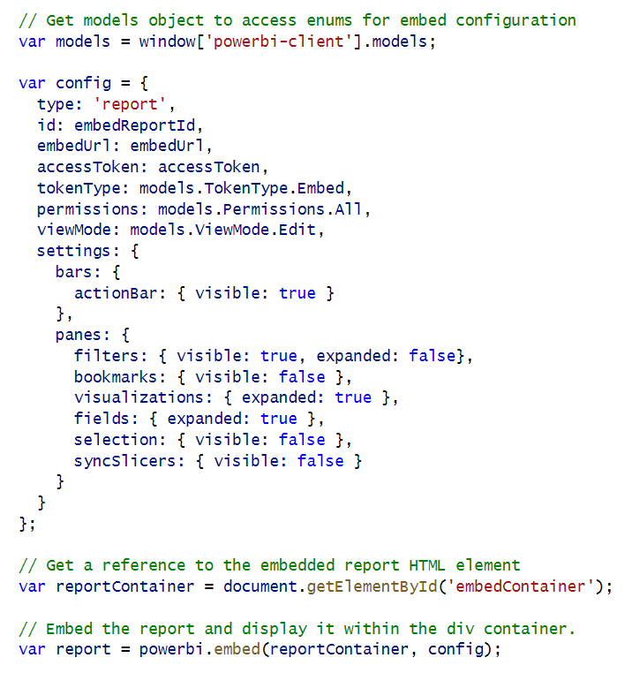
Initializing Panes When Embedding a Report
Demo02
Report panes and action bar can be set in config object
Filter pane and Bookmarks pane are only panes available in View mode
Other panes are only available when report is in Edit mode

Slide 13
Showing and Hiding Report Panes in View Mode
Demo02
You can hide and show panes after report has loaded using code
Show/Hide Filters Pane
Show/Hide Bookmarks Pane

Slide 14
Updating the Display Option Setting
Demo02
Display Option for report pages can be set to Fit To Page | Fit To Width | Actual Size
Display Option set to Fit To Page by default
Report settings for page displayOption must be updated using customLayout setting
Switch report to Fit to Page
Switch report to Fit to Screen
Switch report to Actual size

Slide 15
Agenda
Initializing and Customizing Report Pages
Creating Custom Navigation with Pages and Bookmarks
Creating Authoring Experiences with the Report Designer
Creating New Pages and Adding Visuals using Code
Embedding Reports using Custom Layouts
Adding Personalization Features using Custom Bookmarks

Slide 16
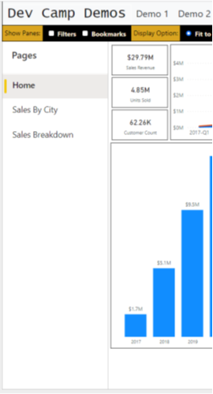
Report Navigation Settings
Demo02
You can show or hide page-based navigation menu used in Power BI Service
Page navigation can be shown on left side of page or bottom of page
set navigation
left navigation
bottom navigation

Slide 17
Creating a Custom Navigation Scheme
Demo02
Custom Navigation can be added using pages or bookmarks

Slide 18
Agenda
Initializing and Customizing Report Pages
Creating Custom Navigation with Pages and Bookmarks
Creating Authoring Experiences with the Report Designer
Creating New Pages and Adding Visuals using Code
Embedding Reports using Custom Layouts
Adding Personalization Features using Custom Bookmarks

Slide 19
Moving a Report into Edit Mode
Demo03
Report can be opened in Edit mode or switched into Edit mode after opening
Minimal code required to switch report into Edit mode
For user to perform Save operation, embed token must have reportId with allowEdit set to true
For user to perform Save As operation, embed token must include workspaceId

Slide 20
GetReportEmbeddingData
Demo03

Slide 21
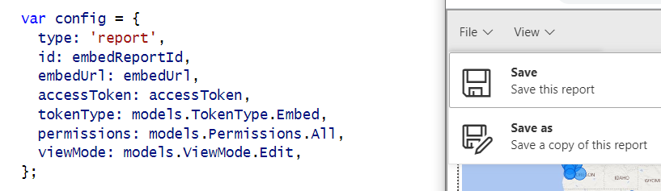
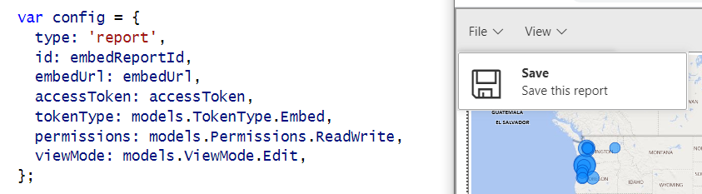
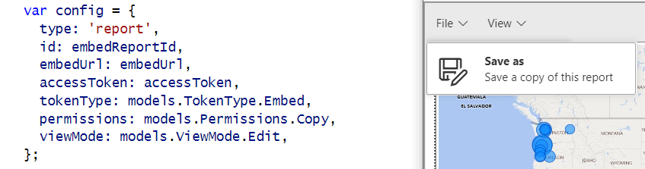
Showing and Hiding the Save and Save as Menus
Demo03
permissions: models.Permissions.All
permissions: models.Permissions.ReadWrite
permissions: models.Permissions.Copy

Slide 22
Implementing the Save-As Redirect
Demo03
saved event fires on both Save and SaveAs actions.
Call to EmbedTokenController Web API to get new embed token with the report ID of the new report

Slide 23
EmbedTokenController Calls GetEmbedToken
Demo03
SaveAs Redirect includes Web API callback to EmbedTokenController
Implemented using jQuery $.ajax() call to EmbedTokenController
Web API call to get updated embed token
Web API call
call to GetEmbedToken

Slide 24
GetEmbedToken
Demo03
Create token request object collections
add IDs for workspaces
add all dataset IDs from source workspace
add all report IDs from source workspace
add all report IDs from target workspace
Create GenerateTokenRequestV2 object
Call Power BI REST API to generate token
Return token to caller as a string

Slide 25
Using a Custom SaveAs Dialog
Demo04
Power BI embedding supports using custom Save As dialog
saveAsTriggered event fires when user in selects Save As command from action bar
Your code must display custom dialog and then execute report.SaveAs

Slide 26
Saving Copy of Report to a Target Workspace
Demo04
When calling report.SaveAs, you can specify a target workspace
Customized reports can be saved and maintained in different workspaces
Embed token requires workspace ID for target workspace

Slide 27
Agenda
Initializing and Customizing Report Pages
Creating Custom Navigation with Pages and Bookmarks
Creating Authoring Experiences with the Report Designer
Creating New Pages and Adding Visuals using Code
Embedding Reports using Custom Layouts
Adding Personalization Features using Custom Bookmarks

Slide 28
Adding the powerbi-report-authoring Library
Demo05
Report authoring features not included with standard powerbi.js library
Add powerbi-report-authoring package to project for authoring features
Add import statement for powerbi-report-authoring to use authoring feature
Importing powerbi-report-authoring extends Report object with new methods
CAVEAT: As of April 2022, authoring features only supported for existing Report objects
Adding authoring features for Create objects (i.e. new reports) is currently a backlog item

Slide 29
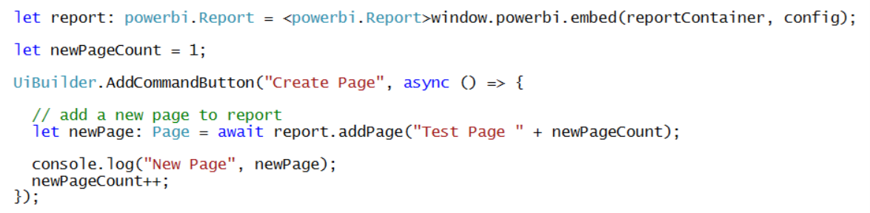
Adding a Page to a Report
Demo05
The code to add a new page is very simple

Slide 30
Understanding Visual Capabilities and Data Roles
Demo05
Visual capabilities can be queried to determine data roles
Data roles allow user to configure visual with fields from data model

Slide 31
Defining Targets for Columns and Measures
Demo05
Adding fields to data roles requires creation of column targets and measure targets
Example of creating a visual and adding target columns and measures to data roles

Slide 32
Creating a Table Visual
Demo05

Slide 33
Create a Column Chart Visual
Demo05

Slide 34
Create a Map Visual
Demo05

Slide 35
Visual Types Available for Programmatic Creation
Demo05
actionButton
areaChart
barChart
basicShape
card
clusteredBarChart
clusteredColumnChart
columnChart
debugVisual
Decomposition Tree
donutChart
esriVisual
filledMap
funnel
gauge
hundredPercentStackedBarChart
hundredPercentStackedColumnChart
image
keyDriversVisual
kpi
lineChart
lineClusteredColumnComboChart
lineStackedColumnComboChart
map
multiRowCard
pieChart
pivotTable
PowerApps
pythonVisual
qnaVisual
ribbonChart
scatterChart
scriptVisual
shapeMap
slicer
stackedAreaChart
tableEx
textbox
treemap
waterfallChart

Slide 36
Agenda
Initializing and Customizing Report Pages
Creating Custom Navigation with Pages and Bookmarks
Creating Authoring Experiences with the Report Designer
Creating New Pages and Adding Visuals using Code
Embedding Reports using Custom Layouts
Adding Personalization Features using Custom Bookmarks

Slide 37
Getting the Names of Pages and Visuals
Demo06
You can discover page names and visual names using Demo01 events explorer
In some scenarios, you might want to hard-code page and visual names into your code

Slide 38
Creating a Static Custom Layout
Demo06
You can set x position, y position, width and height for each visual in a custom layout

Slide 39
Creating a Custom Layout without Hard-coded IDs
Demo06

Slide 40
Displaying a Single Visual
Demo06
Create a custom layout that only display a single visual
Visual can be sized to full width and height of report
Use defaultLayout to hide all other visuals by default.

Slide 41
Agenda
Initializing and Customizing Report Pages
Creating Custom Navigation with Pages and Bookmarks
Creating Authoring Experiences with the Report Designer
Creating New Pages and Adding Visuals using Code
Embedding Reports using Custom Layouts
Adding Personalization Features using Custom Bookmarks

Slide 42
Adding Custom Navigation using Bookmarks
Demo07
Let's start by adding navigation using bookmarks defined inside the report

Slide 43
Capturing a Custom Bookmark
Demo07

Slide 44
Demo08 demonstrates persisting bookmarks in database
Application design support Shared Bookmarks and Personal Bookmarks
Shared bookmark seen by all report consumers
Personal bookmark only seen by user that created it
Bookmarks Controller
SharedBookmarks
table
PersonalBookmarks
table

Slide 45
Tables for Persisting Custom Bookmarks
SharedBookmarks table
PersonalBookmarks table

Slide 46
Loading with Persisted Bookmarks
Demo08

Slide 47
Adding Personalized Report Subscriptions
Demo08
With App-Owns-Data embedding, Power BI does not know user identity
App-Owns-Data embedding does not provide SaaS-style personalization features
Personalization features must be fully implemented by developer
Let's explore application design to support personalized report subscriptions
Start by allow users to save subscription information to ReportSubscriptions table
Implement subscriptions service to read to ReportSubscriptions table and export reports
PDF files for exported reports can be sent to users via email attachment

Slide 48
Summary
Initializing and Customizing Report Pages
Creating Custom Navigation with Pages and Bookmarks
Creating Authoring Experiences with the Report Designer
Creating New Pages and Adding Visuals using Code
Embedding Reports using Custom Layouts
Adding Personalization Features using Custom Bookmarks

Slide 49
Microsoft Power BI
Questions?

